Slide 1
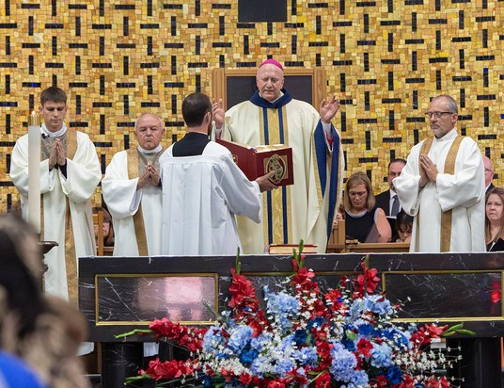
The Diaconate
In the Diocese of Salina

Slide 2
What is a Permanent Deacon?
An ordained ministry
  One of three Holy Orders in the Church:
        Deacon
        Priest
        Bishop
  Not a “little priest,” but an ancient order, dating from the very early Church
  Out of practice for several centuries, but restored by Vatican II

Slide 3
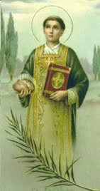
Deacons in History
St. Stephen and the 7 original deacons from the Acts of the Apostles
St. Lawrence
St. Francis of Assisi

Slide 4
What do deacons do?
A ministry of SERVICE:
  To the Word of God (preaching and teaching)
  To the poor (love and justice)
  To the liturgy (sacramental role)

Slide 5
Who is eligible?
Catholic men, between the ages of 35 and 65, who are interested in witnessing, sacramentally, to service.
Men must be age 35 or no older than 65 by June 1, 2031, in order to be ordained. (The bishop may approve an age older than 65 but the candidate will be required to pay part of the formation cost.)
Not doing all the Church’s service themselves, but witnessing to it and “ordering” it, structuring it and calling it forth from others.

Slide 6
Admission Guidelines
Have a good spiritual life and a positive sense of Church. Be committed to the teachings of the Church and to human dignity.
Work well with others, be sensitive to persons with problems and be generous with time and energy in serving others.
Be a man in good standing in the Church for at least 3 years and be an active member of his parish.
Have a stable employment and financial history.
Be a citizen of the US or have evidence of currently being in legal immigration status, and able to maintain such status for the duration of the formation program.

Slide 7
Be without a criminal record.
Possess a high school diploma or GED and be capable of college level studies.
If married, be married in the Church and be in a stable marriage.
If single, be committed to celibacy.
Be able to commit to Saturdays during aspirancy program .
Be able to commit to one full weekend (Friday – Sunday) 11 months a year for four years for the formation program; to attend 8-day homiletics course at St. Meinrad, Indiana, at your expense in the second or third year; and be able to devote 10 hours a week for study throughout years 2-5.

Slide 8
What are the requirements?
Human formation
Spiritual formation
Academic formation
Ministry formation
DESIGNED

Slide 9
How long will the training take?
Four (4) years after discernment.
    At least one year of discernment
    Four years of formation
    A total of 5 years of formation

Slide 10
What is discernment?
Discernment is a time of prayerful consideration about whether one feels called to the diaconate.

Slide 11
The Church will be discerning, too.
Diaconate is a vocation.
Like the ordained priesthood, one does not decide entirely on one’s own.
The Church, through the bishop, must call a man to ordination.
A minimum of 4 candidates will be needed for formation to proceed.

Slide 12
St. Meinrad, School of Theology
St. Meinrad, Indiana www.saintmeinrad.edu/permanent-deacons
23 required courses in:
  Theology
  Scripture
  Canon Law
  Sacraments
  Homiletics (Required travel to St. Meinrad, Indiana for one summer week).

Slide 13
EVALUATION OF CANDIDATES
These courses must be taken for credit.
The criteria for selection and ongoing participation in the program are developed and applied at the diocesan level. Saint Meinrad lecturers evaluate the academic performance of candidates in each course.
Evaluations of candidate interest and performance are also provided by leaders of theological reflection groups and supervisors of ministry assignments.
These evaluation instruments provide information to the diocese that can be used to determine if candidates should be invited to continue formation and if they should be admitted to orders.
In addition, several events will take place, designed to:
  help answer questions regarding the diaconate and discernment
  teach some prayer techniques
  explain further how the vocation to diaconate might look/feel.

Slide 14
How is formation done?
Year of Discernment (1).
  1 Saturday for 9 months from September 19, 2026, through June 2027, in a centralized location to be determined, approximately 10am to 4pm.
  1 weekend retreat (Friday evening – Sunday noon) in summer of 2027.
Formation years (4).
  1 weekend a month from September 2027, through May 2031, in a centralized location to be determined. .
  1 weekend retreat each summer.
  1-week Homiletics Course at St. Meinrad, Indiana, for one summer. The candidate must pay their trave costs.
  Multi-day canonical retreat Spring 2031, preceding ordination.
  Ministerial internships/clinicals.

Slide 15
How are the weekends structured?
TYPICAL WEEKEND SESSION
FRIDAY
TYPICAL WEEKEND SESSION
FRIDAY
6:45 p.m. | Evening Prayer
7:00-9:00 p.m. | Class Sessions
9:00 p.m. | Social (Optional)

Slide 16
SATURDAY
7:40 AM. Morning Prayer
8:00 AM. Breakfast
8:30 – 11:30 AM Class Sessions
12:00 PM Lunch
1:00 - 2:00 PM Class Session
2:00 - 2:15 PM Break
2:15 - 4:00 PM Formation Session
4:00 – 5:00 PM Break – Confession is available at St. Fidelis
5:00 – 6:00 PM Mass at St. Fidelis
6:00 PM Dinner
6:45 - 7:00 PM Evening Prayer
7:00 - 9:00 PM Class Sessions
9:00 PM Class Social - Optional

Slide 17
Sunday
8:00 a.m. | Breakfast
9:00 – 9:15 a.m. | Morning Prayer
9:15 – 1:15 pm | Class Sessions
At the completion of the formation program, St. Meinrad will award 18 hours of graduate credit towards a 36-hour credit Master of Arts (Theology) degree at St. Meinrad (for those admitted to St. Meinrad, School of Theology graduate program).

Slide 18
What is the financial cost?
The diocese assumes the cost of tuition for the program administered by St. Meinrad.
Candidates will be responsible for travel to St. Meinrad for 1-week homiletics course.
Candidates will be responsible for mileage to all events and any required textbooks.
Candidate’s room and board are paid by the diocese. If a wife attends, the cost is paid by the candidate.

Slide 19
Is the ministry full time?
No, not under normal circumstances
Diaconate is a volunteer ministry
It is a ministry of men living and working in the world, with a special dedication to prayer and ministry.
Deacons are clergy, but they form a link between clergy and laity.

Slide 20
What about marriage?
If a man is ordained after he is already married, he remains married.
If his wife dies, he will not be free to marry again.
If he is single when he is ordained, he must take a vow of celibacy.

Slide 21
What is the wife’s involvement?
For many deacons, their first vocational call was to marriage. Diaconate should not interfere with that but, rather, becomes a particular living-out of the marriage commitment.
Therefore, wives must agree to this ministerial call.

Slide 22
Are wives invited?
Candidates’ wives are invited to everything:
    Discernment events
    Formation events
    Retreats
    Continuing education events, after ordination
Wives are strongly encouraged, but not required, to attend events.
Throughout the program, it is important to maintain the distinction between the ordained ministry of the deacon and the ministerial activities of his wife, which she carries out as a lay person in her own right.

Slide 23
Application Process
Pray and think yourself
If married, confer with wife and obtain her consent.
Fill out application papers and submit – Mailed to Deacon Steven Frueh, 6296 W. Watkins Road, Salina, KS, 67401, by June 1, 2026. Request application today and leave email address or email deaconsteve@stmsalina.org and the application will be forwarded to you. Many documents need to accompany your application!
Background/Reference/etc., checks.
Formation team reviews and makes recommendation to bishop, who makes the final decision.

Slide 24
6. Acceptance into aspirancy/discernment process – letters
go out approximately August 7th, 2026.
Discernment process.
Psychological Evaluation at diocesan expense.
Acceptance into formation studies.
Follow-up interviews throughout formation process.
Successful completion of all aspects of the formation.
Call to Holy Orders by Bishop.
Ordination.

